Slide 1
Text-to-Animation User Guide

Slide 2
Install
GCP
Rhubarb
Virtual environment
Workflow
Command-line options
Source images

Slide 3
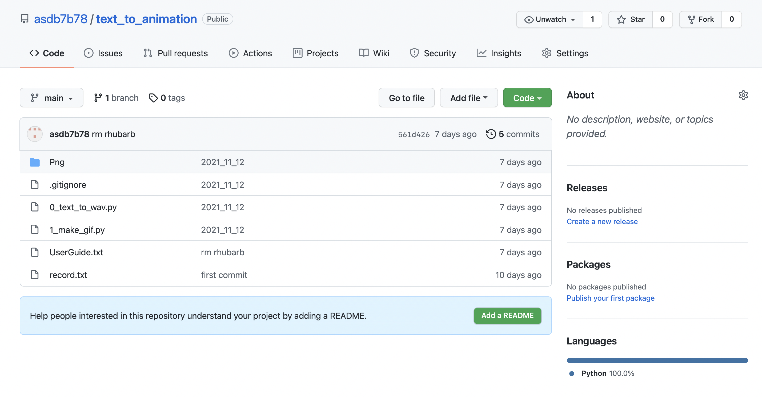
Install
Download from github: https://github.com/asdb7b78/text_to_animation

Slide 4
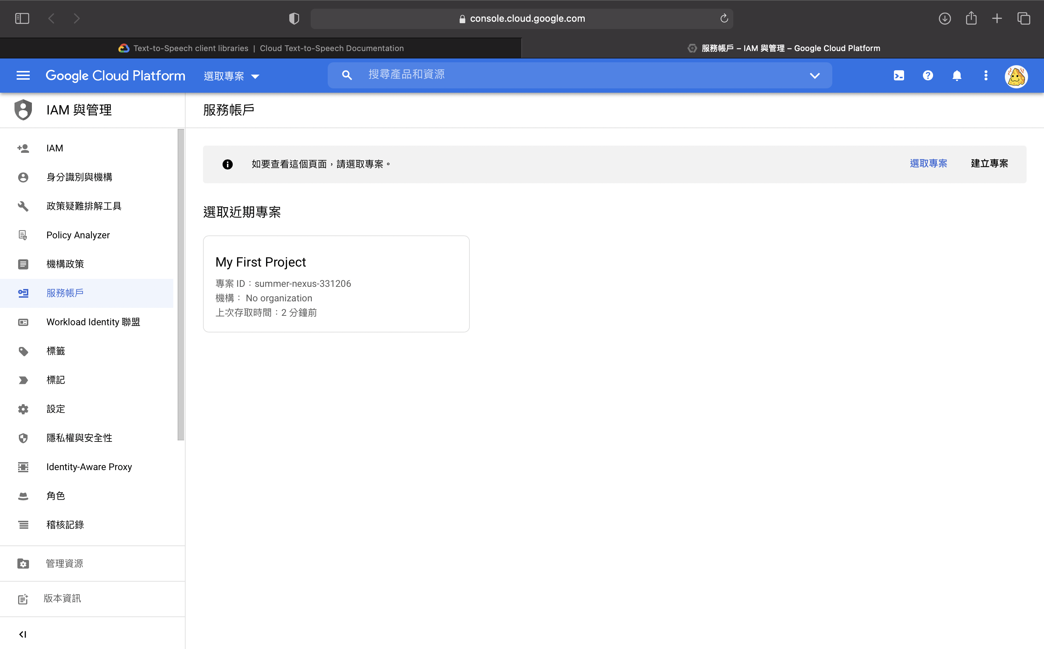
GCP
Setting up authentication, create project, service account and start up text-to-speech api。https://cloud.google.com/text-to-speech/docs/libraries
2
1

Slide 5
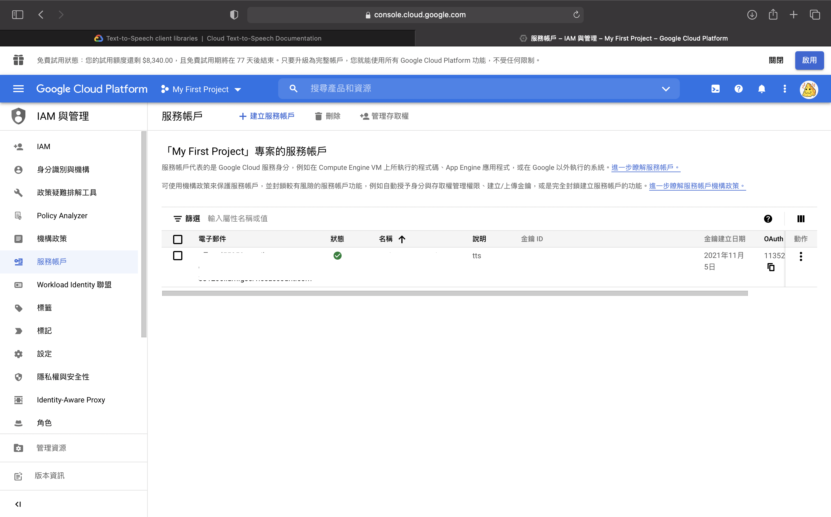
3
4

Slide 6
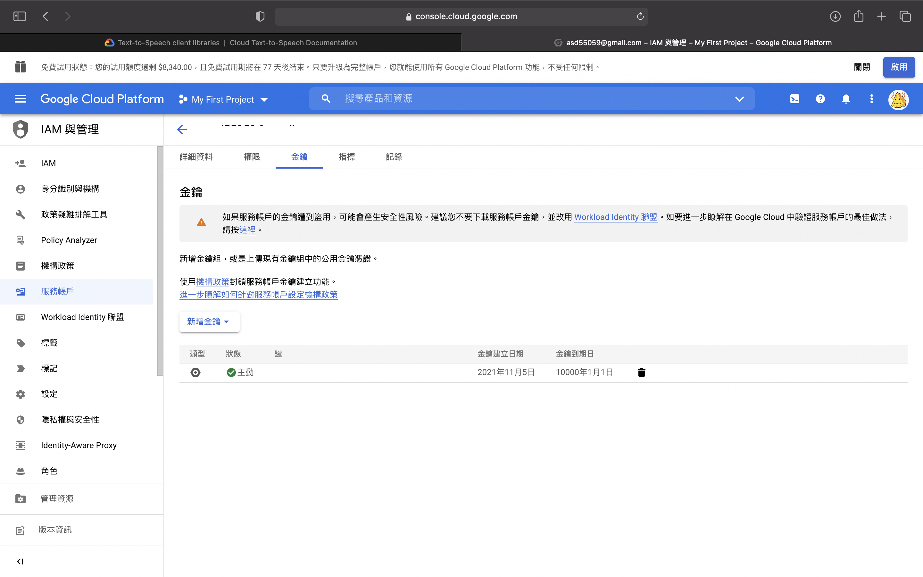
5
6

Slide 7
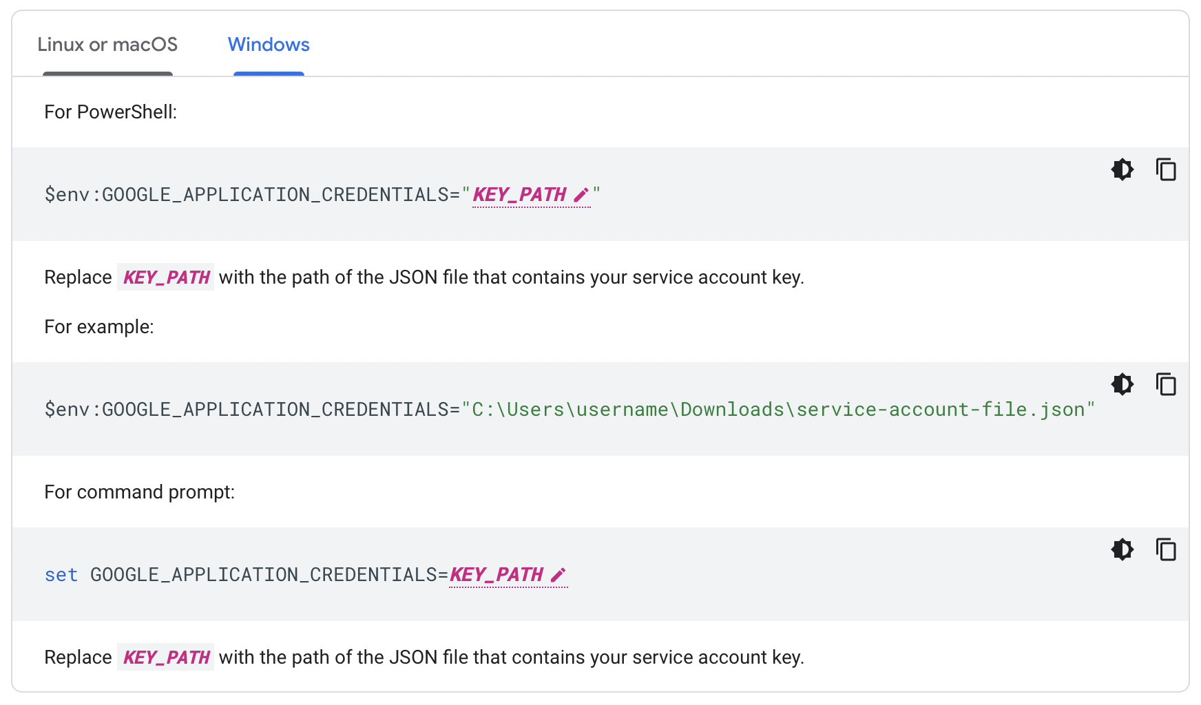
GCP
Download .json key and then set path to GOOGLE_APPLICATION_CREDENTIALS.

Slide 8
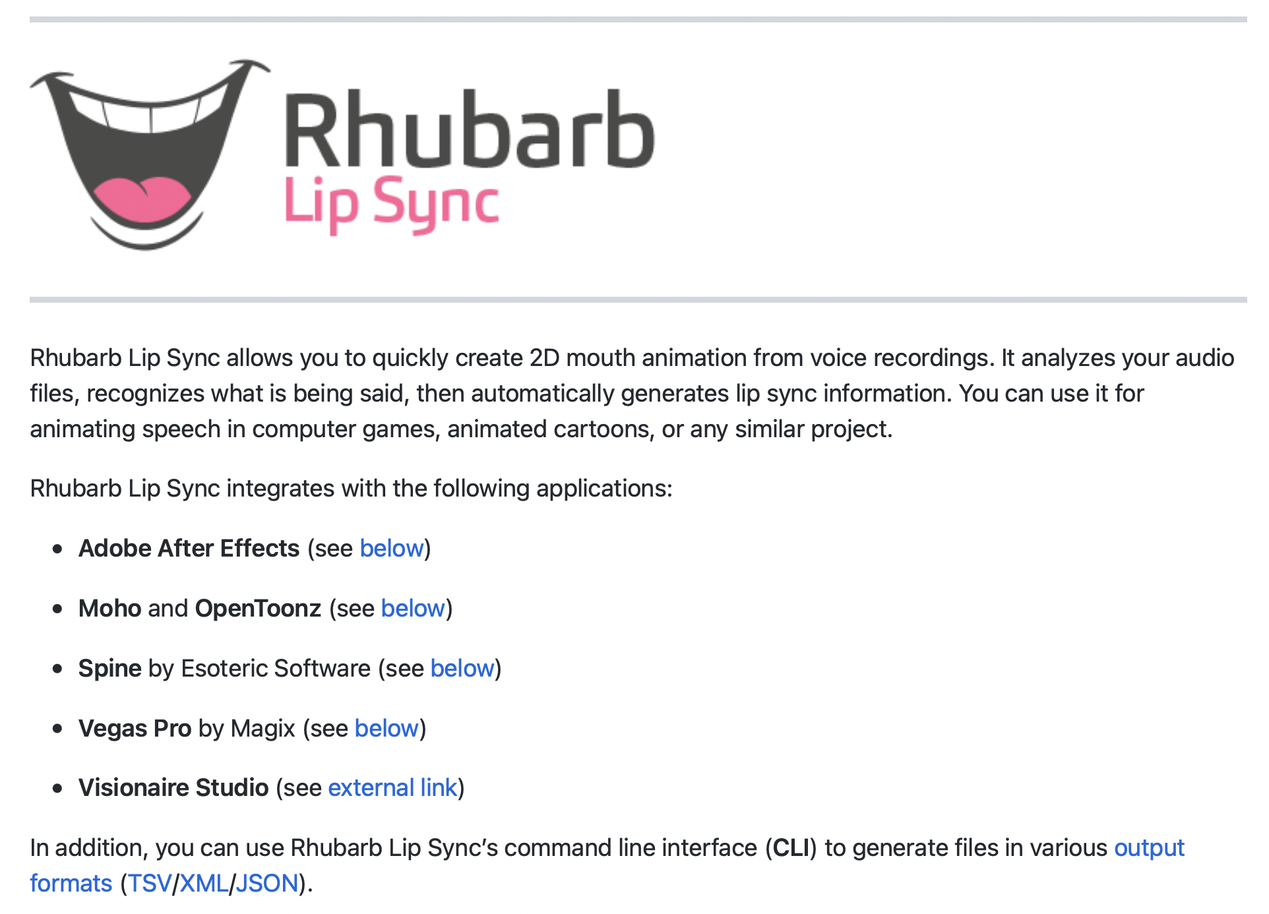
Rhubarb

Slide 9
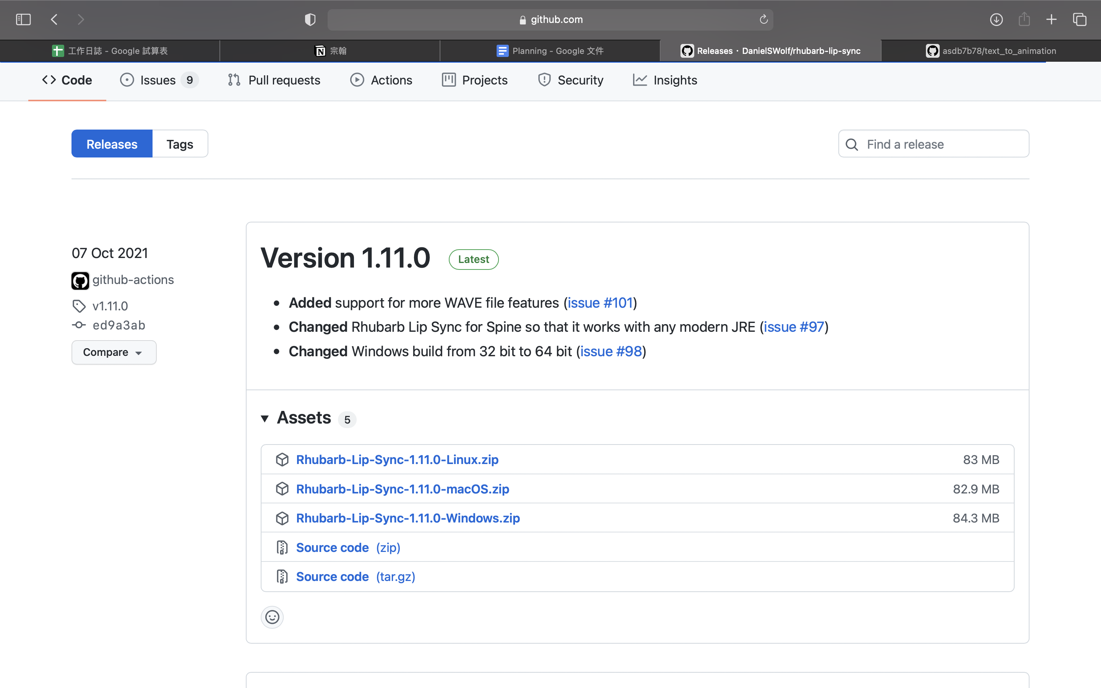
Rhubarb
Download: https://github.com/DanielSWolf/rhubarb-lip-sync/releases

Slide 10
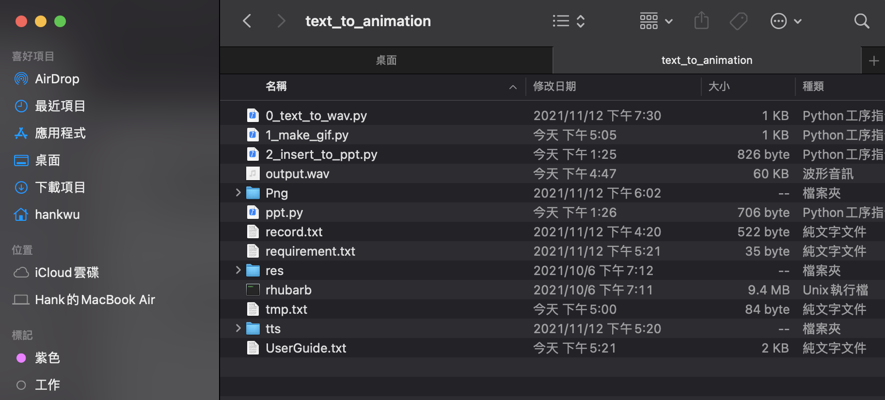
Rhubarb
Put folder ‘res' and ‘rhubarb.exe’(or'rhubarb') to ‘text_to_animation'.

Slide 11
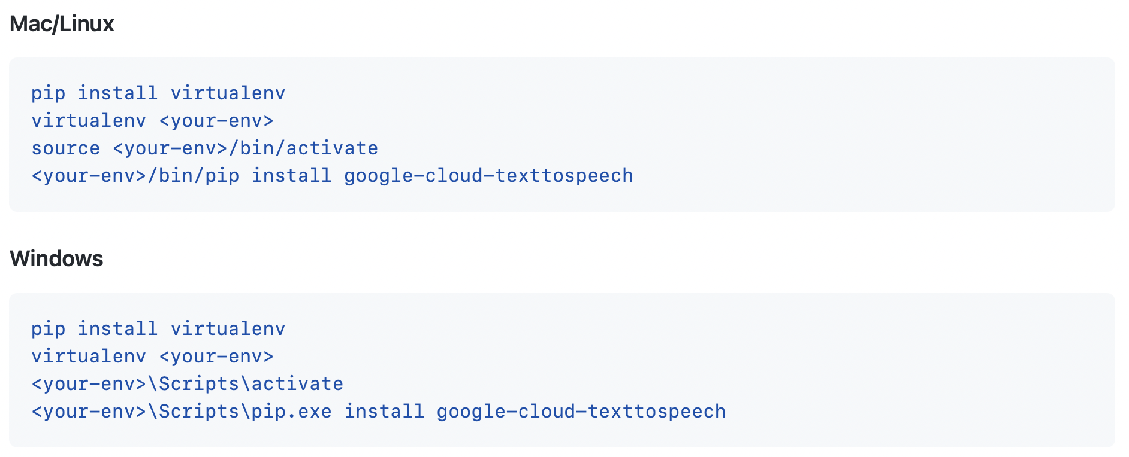
Set up virtual environment

Slide 12
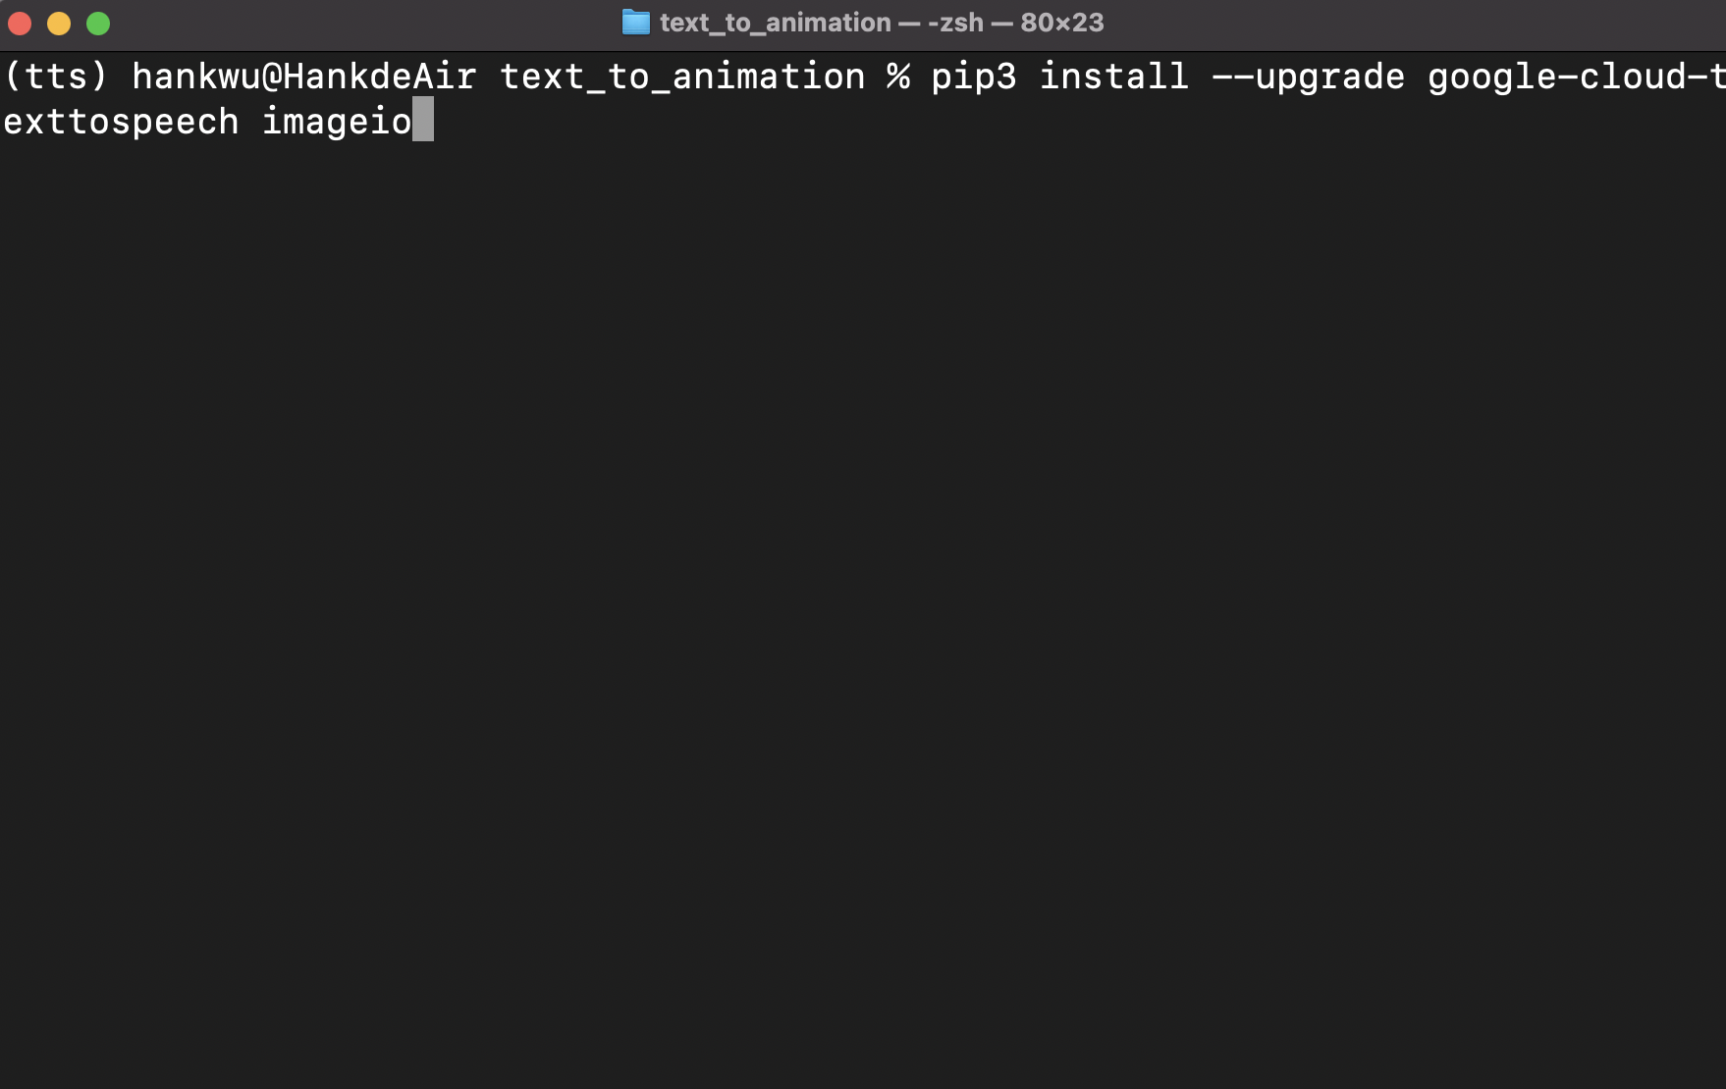
Install Python package in virtual env
Command: 'pip3 install --upgrade google-cloud-texttospeech imageio'

Slide 13
Workflow
0_pptx_to_text.py
1_text_to_wav.py
source
pptx
Wav
text.txt
2_make_gif.py
3_insert_to_ppt.py
Rhubarb
mouth.txt
Gif
source
PNG
Pptx

Slide 14
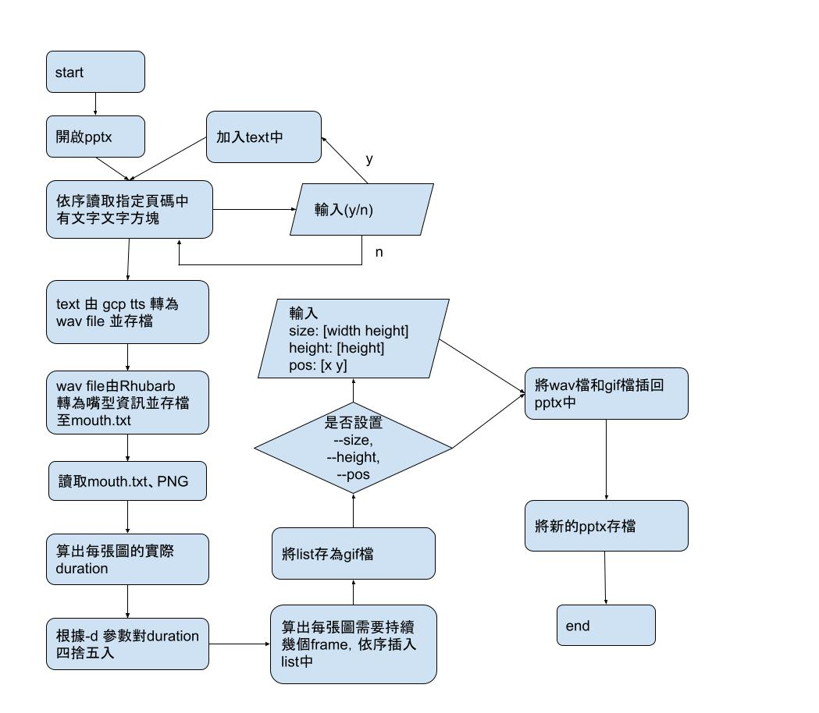
Workflow

Slide 15
Command-line options
usage:
python3 main.py [-n NAME] [-f FOLDER] [-d DURATION] [--size] [--height] [--pos] <pptx> <page>
pptx: path to pptx.
page: page to insert sound and gif.
-n: name of output wav and gif file.
-f: source image folder in ‘PNG’.

Slide 16
Usage and args
-d: minimum duration of every image in gif. (unit: second)
--size: a flag to resize the image by new width and new height. (unit: pixel)
--height: a flag to scale the gif by a new height. (unit: pixel)
--pos: a flag set the position of gif, default is (0, 0). (unit: pixel)

Slide 17
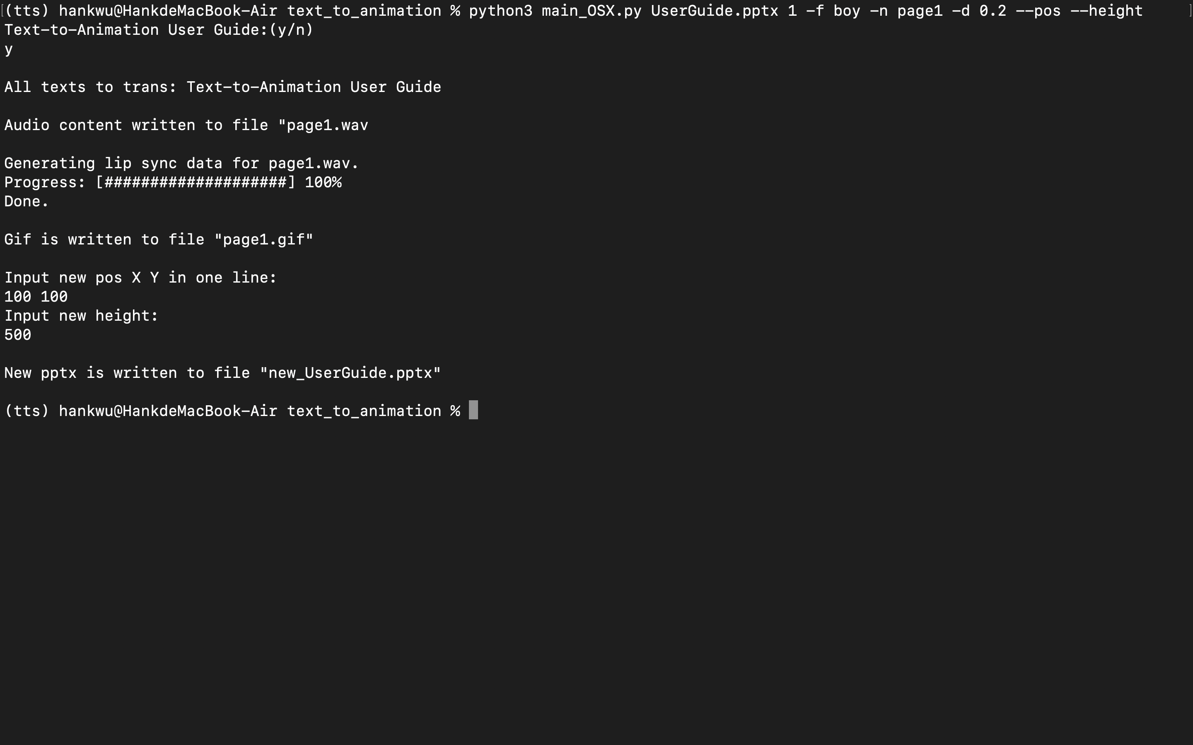

Slide 18
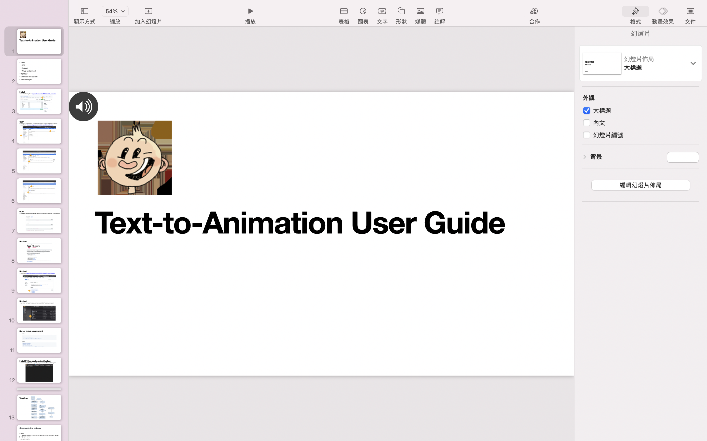

Slide 19
Source images
rhubarb will convert the audio file into 9 mouth shapes A~H and X, where A and X are the same
As long as the PNG images of the 8 mouth shapes are named A~H according to the corresponding mouth shape, put them into a folder and then put it into ‘PNG’, it can be used by setting the -f parameter.
The default sources is ‘Lip’, and ‘boy’ can be used.
8 mouth shape can be found on GitHub: https://github.com/DanielSWolf/rhubarb-lip-sync

